Slide 1
AI-Systems Machine Learning Lifecycle
Joseph E. Gonzalez
Co-director of the RISE Lab jegonzal@cs.berkeley.edu

Slide 2
Objectives For Today
Introduce the machine learning lifecycle
Challenges and Opportunities
Science vs Engineering
Review Key Concepts in Readings
Hyperparameters
Model Pipelines, Features, and Feature Engineering
Warm Starting and Fine Tuning
Feedback Loops, Retraining and Continuous Training
Important Context for Papers and what to expect.

Slide 3
What is the Machine Learning Lifecycle?

Slide 4
Identifying potential sources of data
Joining data from multiple sources
Addressing missing values and outliers
Plotting trends to identify anomalies
Help!

Slide 5
Identifying potential sources of data
Joining data from multiple sources
Addressing missing values and outliers
Plotting trends to identify anomalies
Help!
Happy to JOIN

Slide 6
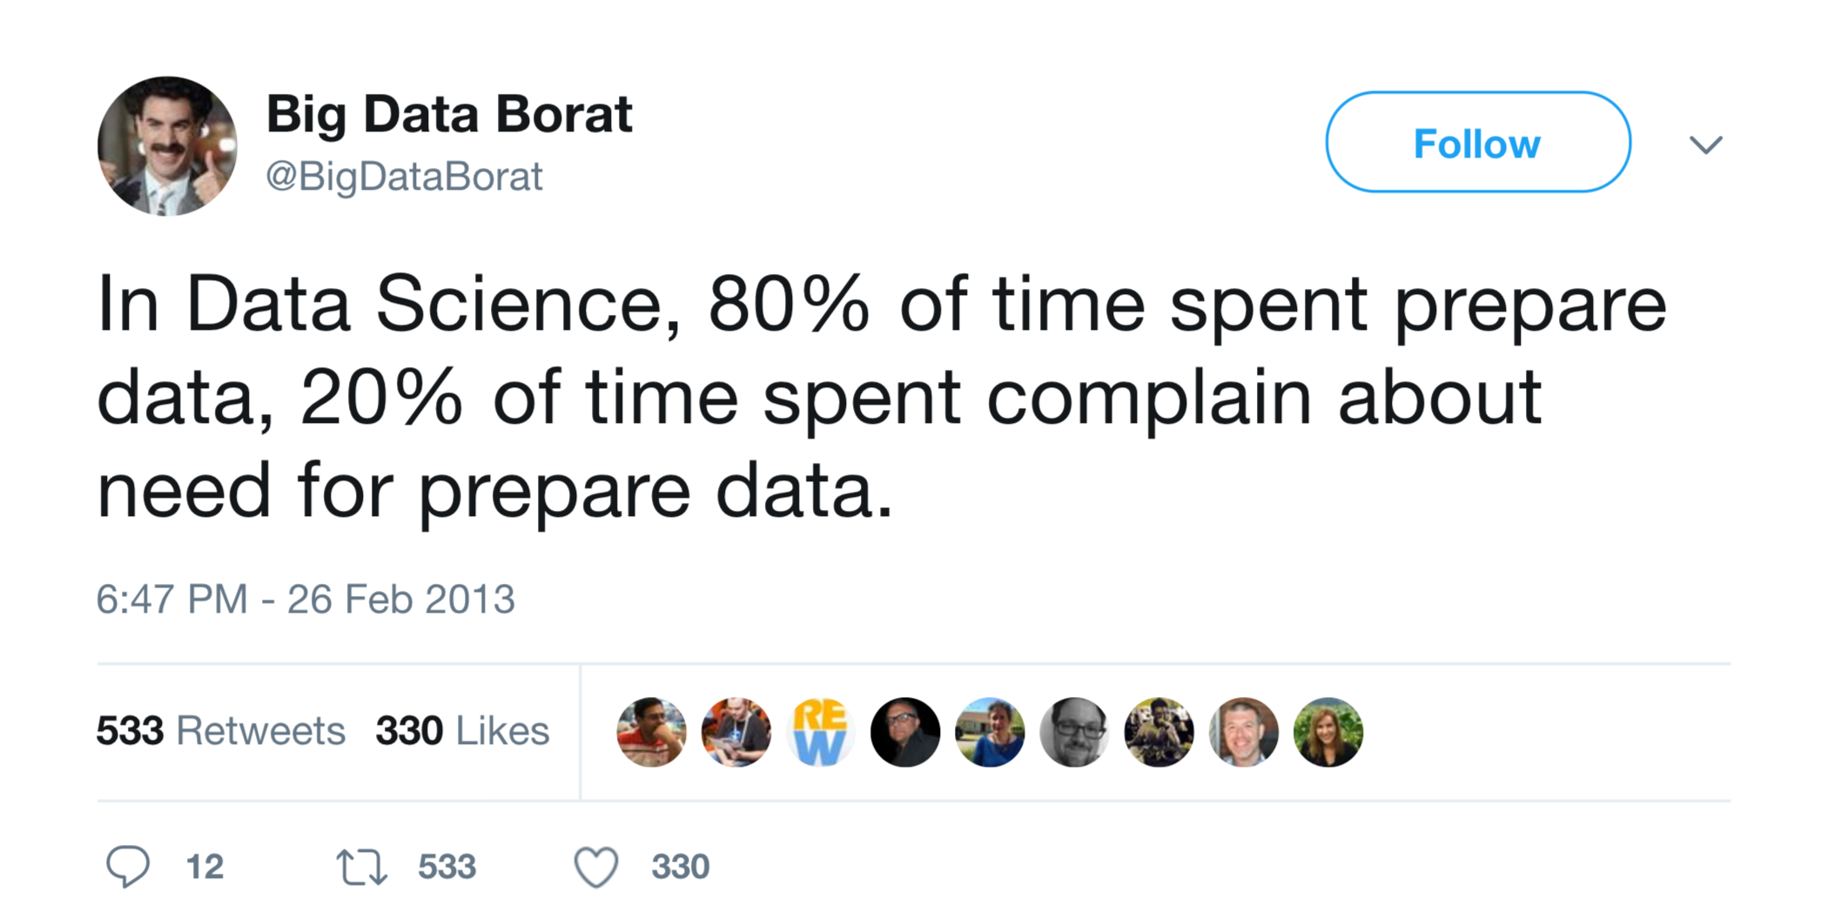

Slide 7
Andrej Karpathy (Tesla Auto Pilot Team)
How many of you have ever worked with real data?

Slide 8
Identifying potential sources of data
Joining data from multiple sources
Addressing missing values and outliers
Plotting trends to identify anomalies
Help!
Happy to JOIN

Slide 9
Building informative features functions
Designing new model architectures
Tuning hyperparameters
Validating prediction accuracy
I was born for this!

Slide 10
Features and Feature Engineering
Features: properties or characteristic of the input
Click Prediction Example:
Features function extract numeric properties from x
Simple Logistic Model:
(”Perceptron”)*
Information about User and Content
Useful features?
Model:
e.g., Recurrent NN output..
User Features:
age, gender, and click history
Product Features:
Price, popularity, and description…
Combined (Cross) features:
I(20 < age < 30, male, “xbox” in desc)…
e.g., Language Model Embedding
Probability user will click on the content
Hand coded features
* Technically the original perceptron used a 0/1 non-linearity but this is a common abuse of terminology.

Slide 11
Additional Notes on Features
Feature Joins: combine multiple data source in a feature
Feature Reuse: good features can aid in many tasks
Example: product embeddings, user tags, …
Predictions as Features: predictions for one task (e.g., products in an image) can be useful features for another (e.g., ad targeting)
Feature Tables/Caches: features are often pre-computed and cached
Requires tracking data and compute and feature versions
Dynamic Features: features can often be modified faster than models
Useful for addressing fast changing dynamics (e.g., user preferences can be encoded in click history features).
Issue: resulting potential covariate shift can be problematic

Slide 12
Hyperparameters
the parameters and more generally configuration details that are not directly determined through training
set by hand or tuned using cross validation
why not learn directly?
Find the Hyperparameters:
Objective:
Training Algorithm
Architecture is sometimes treated as separate from hyperparameters
Architecture:
Can be learned…

Slide 13
Technologies

Slide 14
What is the output of
Reports & Dashboards
(insights …)
Trained Model
Bad Idea

Slide 15
What is the output of
Why is it a Bad Idea to directly produce trained models from model development?
With just a trained model we are unable to
retrain models with new data
track data and code for debugging
capture dependencies for deployment
audit training for compliance (e.g., GDPR)
Trained Models

Slide 16
What is the output of
Reports & Dashboards
(insights …)
Trained Models
Bad Idea

Slide 17
What is the output of
Reports & Dashboards
(insights …)
Training Pipelines

Slide 18
Training Pipelines Capture the Code and Data Dependencies
Description of how to train the model from data sources
Training Pipelines
Trained
Models
Training Data
Software Engineering
Analogy
Training Pipelines → Code
Trained Models → Binaries

Slide 19
What is the output of
Reports & Dashboards
(insights …)
Training Pipelines

Slide 20
What is the output of

Slide 21
Training models at scale on live data
Retraining on new data
Automatically validate prediction accuracy
Manage model versioning
Requires minimal expertise in machine learning

Slide 22
Technologies
Workflow Management:
Apache
Airflow
Scalable Training:

Slide 23
Warm Start Training
Loss Surface for a two-parameter model.
Stochastic
Gradient Descent

Slide 24
Warm Starts Training
Works well if data is changing slowly.
1)
New training data arrives and changes the loss surface.
More challenging for model changes.
2)
Instead of starting over from random weights start at previous solution.
Loss Surface for a two-parameter model.
Stochastic
Gradient Descent

Slide 25
Additional Thoughts on Warm Starting
A form of transfer learning across time.
Useful for situations where new data is arriving
Equivalent to continuing training larger dataset (assuming old data is still used)
Issues
Need a mechanism to set learning rates appropriately
Typically start much smaller
Could get stuck in suboptimal solution for non-convex settings
Though this is true in general
Catastrophic forgetting: if you only train on new data may degrade model on old data

Slide 26
Fine Tuning
Using small learning rates to train pre-trained or partially pre-trained model for a new dataset or prediction task.
Both speeds up training and can improve accuracy
X Y
X Y
x
y
Add new top layer(s)
x
z
Warm
Starting
Warm
Starting
X Y
X Z
x
z
x
z
x
z
Training just the top layer
Training all
layers
Small Change + Additional Data
Change in the prediction task

Slide 27
Open Problems
Context
& Composition

Slide 28
How, What, & Who?
Context
How was the model or data created?
What is the latest or best version?
Who is responsible? (blame...)
Track relationships between
Code versions
Model & Data versions
People (versions?)
Partial
Solution
✓
Training Pipelines

Slide 29
Composition
Models are being composed to solve new problems
Cuteness Detector
Cute!

Slide 30
Composition
Models are being composed to solve new problems
Puppy
Detector
Yes
Cuteness Detector
Cute!
Ball Detector
Yes

Slide 31
Composition
Models are being composed to solve new problems
Puppy
Detector
Wrong but helpful…
Yes
Cuteness Detector
Still Correct
Cute!
Ball Detector
Yes
Notes:
composition

Slide 32
Composition
Models are being composed to solve new problems
Puppy
Detector
Wrong but helpful…
Yes
Cuteness Detector
Still Correct
Cute!
Ball Detector
Yes

Slide 33
Composition
Models are being composed to solve new problems
Puppy
Detector
Reasonable Improvement
No
Cuteness Detector
Not Cute!
Ball Detector
Degradation in accuracy
Yes
Notes:
fasdf

Slide 34
Composition
Models are being composed to solve new problems
Need to track composition and validate end-to-end accuracy.
Puppy
Detector
Reasonable Improvement
Need unit and integration testing for models.
No
Cuteness Detector
Not Cute!
Ball Detector
Degradation in accuracy
Yes
Notes:
fasdf

Slide 35
What is the output of

Slide 37
Goal: make predictions in ~10ms under bursty load
Complicated by Deep Neural Networks ➔ New ML Algorithms and Systems

Slide 38

Technologies

Slide 39

Technologies
My system →
Specialized for Particular Models or Frameworks

Slide 40
Incorporating Feedback
Model updates: retrained as new data
Periodically: leverage batch processing and validation
Model could be out-of-date for extended period of time
Continuously (online learning): most fresh model
Needs validation, learning rates? … complicated
Feature updates: new data may change features
Example: update click history for a users → new predictions
Can be more robust than online learning

Slide 41

Feedback Cycles
Models can bias the data they collect
Example: content recommendation
Future models may reflect earlier model bias
Exploration – Exploitation Trade-off
Exploration: observe diverse outcomes
Exploitation: leverage model to take predicted best action
Solutions
Randomization (ε-greedy): occasionally ignore the model
Bandit Algorithms/Thompson Sampling: optimally balance exploration and exploitation → active area of research

Slide 42
Machine Learning Lifecycle
We will cover each phase in more detail throughout the semester but this week we focus on managing the entire process.

Slide 43
Objectives For Today
Introduce the machine learning lifecycle
Challenges and Opportunities
Science vs Engineering
Review Key Concepts in Readings
Hyperparameters
Model Pipelines, Features, and Feature Engineering
Warm Starting and Fine Tuning
Feedback Loops, Retraining and Continuous Training
Important Context for Papers and what to expect.

Slide 44
Reading for the Week
Hidden Technical Debt in Machine Learning Systems
NeurIPS’15, widely cited
Provides an overview of the challenges from Google
TFX: A TensorFlow-Based Production-Scale Machine Learning Platform
KDD’17, now part of https://www.tensorflow.org/tfx (sort of)
Googles solution to the challenges in the first paper
Towards Unified Data and Lifecycle Management for Deep Learning
ICDE’17, Video Demo
An alternative database community solution

Slide 45
Related Systems Efforts
Doing Machine Learning the Uber Way: Five Lessons From the First Three Years of Michelangelo
System overview
Introducing FBLearner Flow: Facebook’s AI backbone
KubeFlow: Kubernetes Pipeline Orchestration Framework
DeepBird: Twitters ML Deployment Framework
Demonstration of Mlflow: A System to Accelerate the Machine Learning Lifecycle
Databricks software product (with open-source version)

Slide 46
Hidden Technical Debt in Machine Learning Systems
Technical Debt: long term development and maintenance costs incurred by expedient design decisions
Key Idea: machine learning deployments often incur substantial technical debt (compared to traditional software)
Contribution: this paper characterizes the forms of technical debt and alludes to possible compensating actions

Slide 47
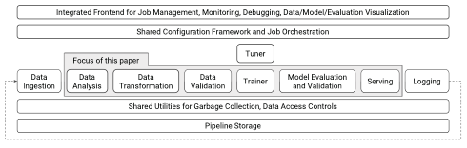
TFX: A TensorFlow-Based Production-Scale Machine Learning Platform
Describes solutions to many of the problem outlined in the technical debt paper.
Key Idea: Adapt best practices for software development to address machine learning lifecycle
empathetic to the reality of “machine learning developers”
Contributions: actual system, interesting ideas around data and model validation, schema enforcement, and meaningful errors.

Slide 48
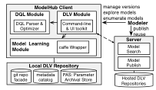
Towards Unified Data and Lifecycle Management for Deep Learning
Describes a system (ModelHub) for managing, querying, and manipulating models and their related metadata.
Key Idea(?): Model lifecycle management combines code and data (parameters) → a natural API would then combine version control commands with SQL-like querying.
Solution: Combines a git-like client API with a SQL-like querying interface to enable basic actions and more complex queries.
Leverages optimizations to store model weights more efficiently.
(necessary?)

Slide 49
What to think about when reading
How does the work differentiate between engineering and research challenges?
What are the key research challenges proposed and addressed?
Are the proposed solutions too opinionated
Would they require top down mandates for adoption?
Would you use these systems?
Are they sufficiently flexible to support innovation

